Slide 1
Guided Capstone Project
Big Mountain ski resort presentation

Slide 2
Overview
Big Mountain Resort, a ski resort located in Montana offers spectacular views of Glacier National Park and Flathead National Forest, with access to 105 trails. Every year about 350,000 people ski or snowboard at Big Mountain. This mountain can accommodate skiers and riders of all levels and abilities.
These are serviced by 11 lifts, 2 T-bars, and 1 magic carpet for novice skiers. The longest run is named Hellfire and is 3.3 miles in length. The base elevation is 4,464 ft, and the summit is 6,817 ft with a vertical drop of 2,353 ft.
The resort has recently installed an additional chair lift to help increase the distribution of visitors across the mountain. This additional chair increases our operating costs by $1,540,000 this season.
The resort's pricing strategy has been to charge a premium above the average price of resorts in its market segment.

Slide 3
Problem identification
The purpose of Big Mountain ski resort project is to build a pricing model for the ski resort ticket in its market segment.
The result should also demonstrate what changes could be made to maximize the resort return, capitalize on existing resort’s facilities. As well as to provides recommendations for the resort’s new investment strategy (future facilities) based on the importance of some facilities compare to others and produce a guidance for Big Mountain's pricing in the future.

Slide 4
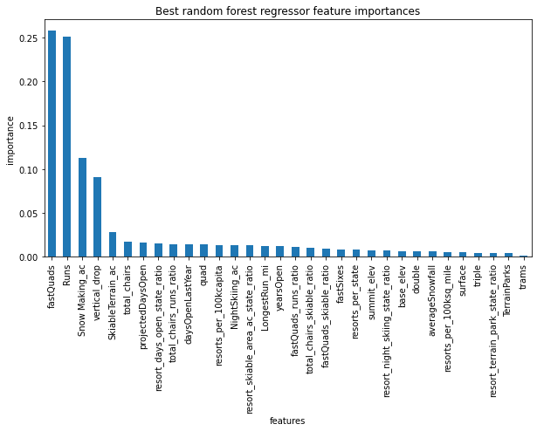
The top four features that raises ticket prices
Our model suggested that the ticket
price should depends on the resort’s
facilities. We found out that the
following features are the features
customers are willing to pay extra
fastQuads
Runs
Snow Making_ac
vertical_drop
The results show that Big Mountain resort is already in high up league tables for all features among the other resorts.

Slide 5
Pricing
Our model suggest that the Big Mountain Resort price should be $95.87, the actual price is $81.00. Even with the expected mean absolute error of $10.39, this suggests there is room for an increase.
It seems that our resort seems to be charging that much less that what's predicted suggests our resort might be undercharging.
We checked where Big Mountain sits overall amongst all resorts for price and for just other resorts in Montana.
The Big Mountain ticket price is in middle range comparing with other resorts in US but it is one of the most expensive resorts in the state of Montana (see histograms below)

Slide 6
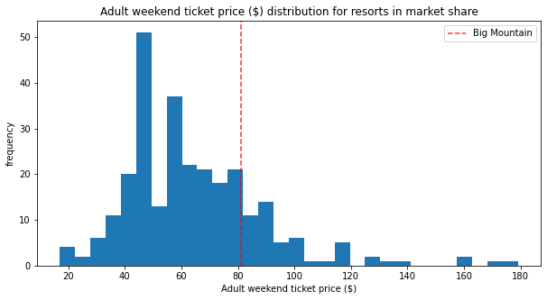
Price distribution for resorts in US

Slide 7
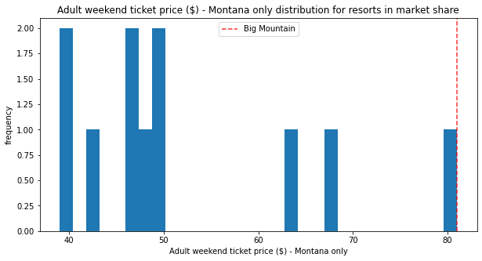
Price distribution for resorts in Montana

Slide 8
Modeling scenarios
1. Permanently closing down up to 10 of the least used runs.
Big Mountain resort has 105 runs. Our model showed that closing one run will make no difference on price and revenue. Closing 2 and 3 reduces support for ticket price and so revenue. If Big Mountain closes down 3 runs, it seems they may as well close down 4 or 5 as there's no further loss in ticket price. Increasing the closures down to 6 or more leads to a large drop.
2. Increase the vertical drop by adding a run to a point 150 feet lower down but requiring the installation of an additional chair lift to bring skiers back up, without additional snow making coverage
Increasing the vertical drop by 150 feet, and installing an additional chair lift. This scenario increases support for ticket price by $1.99. Over the season, this could be expected to amount to $3474638
3. Same as number 2, but adding 2 acres of snow making cover
Such a small increase in the snow making area makes no difference.
4. Increase the longest run by 0.2 mile to boast 3.5 miles length, requiring an additional snow making coverage of 4 acres
No difference whatsoever.

Slide 9
Summary
Although, the Big Mountain resort seems a very well equipped and very well priced among other resorts in the US and our model suggests to increase the price based on the other states data but Big Mountain is already on the top price range within the state we would not recommend to increase the current price without an additional research.
We know that resort has about 350 000 visitors every year but we know nothing about the occupancy (is it fully booked the whole season?).
We would also recommend to consider creating a ticket packages for long-term and the short-term visitors instead of current fix price per day.
Another option we would recommend for the further research is how the resort could reduce the operating cost. Currently we do not have this data
Notes:
Currently

